Slide 1


Slide 2

WHAT IF?

Slide 3
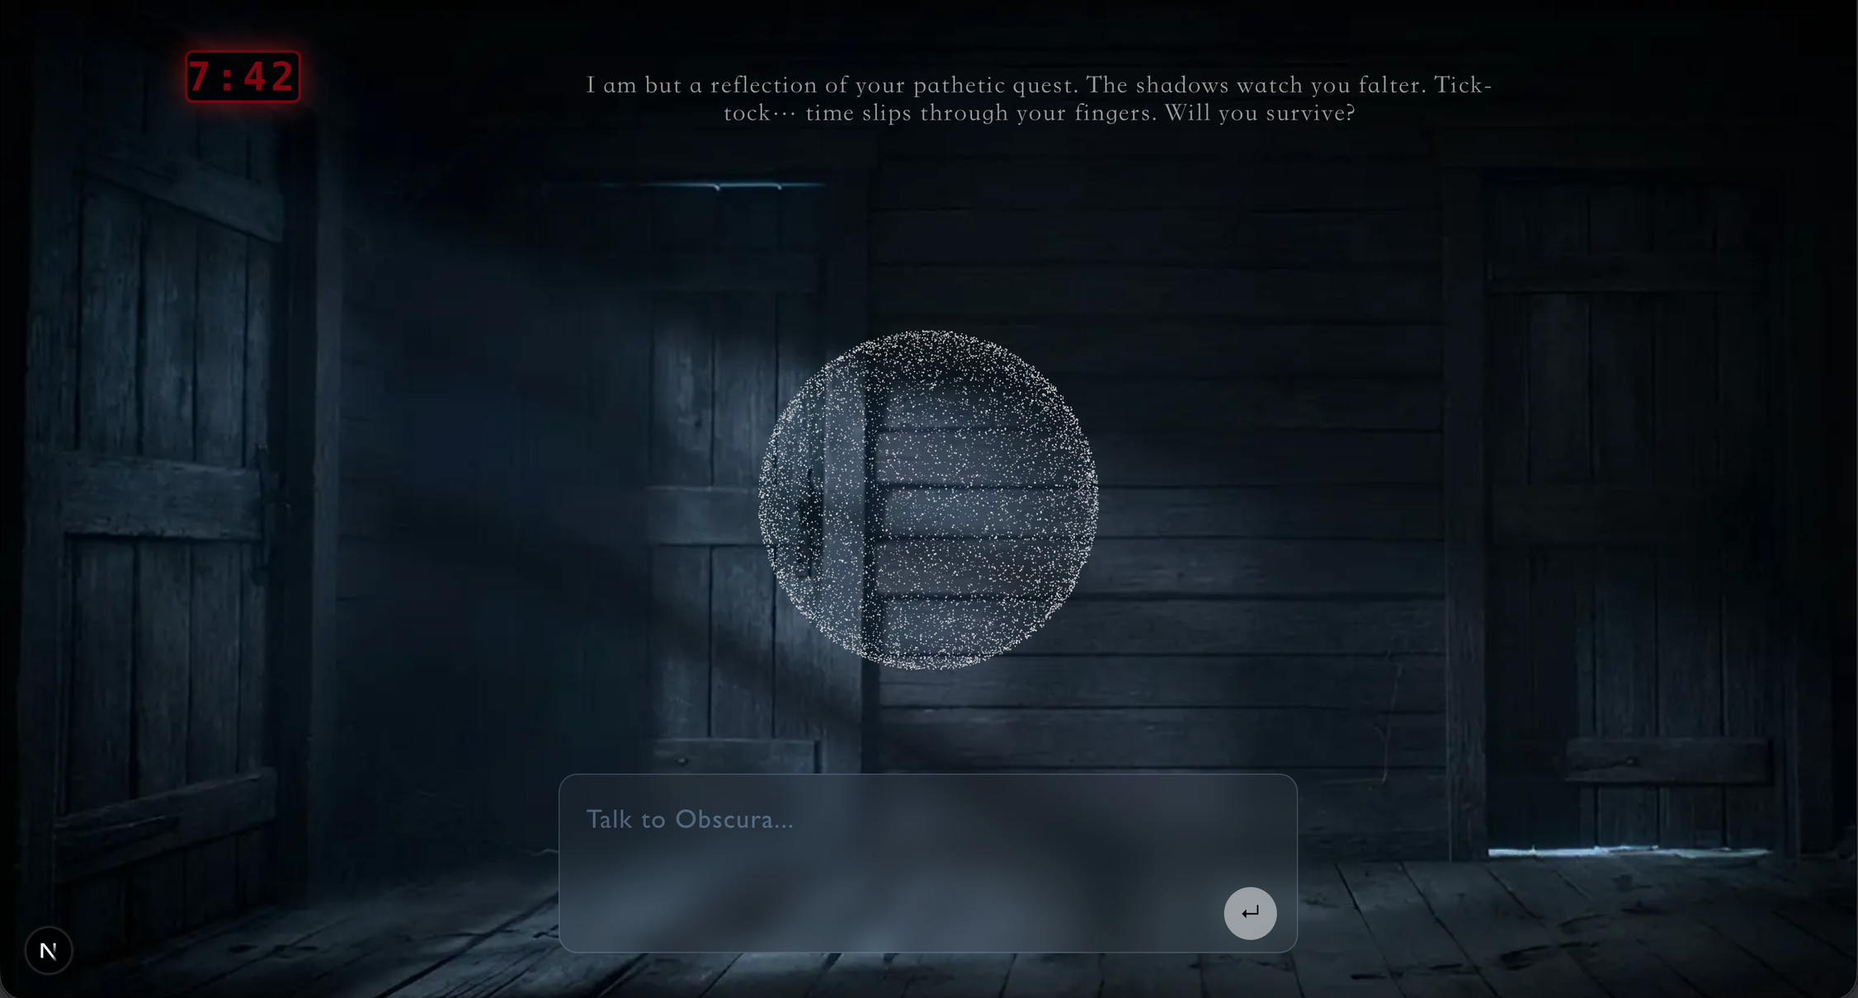
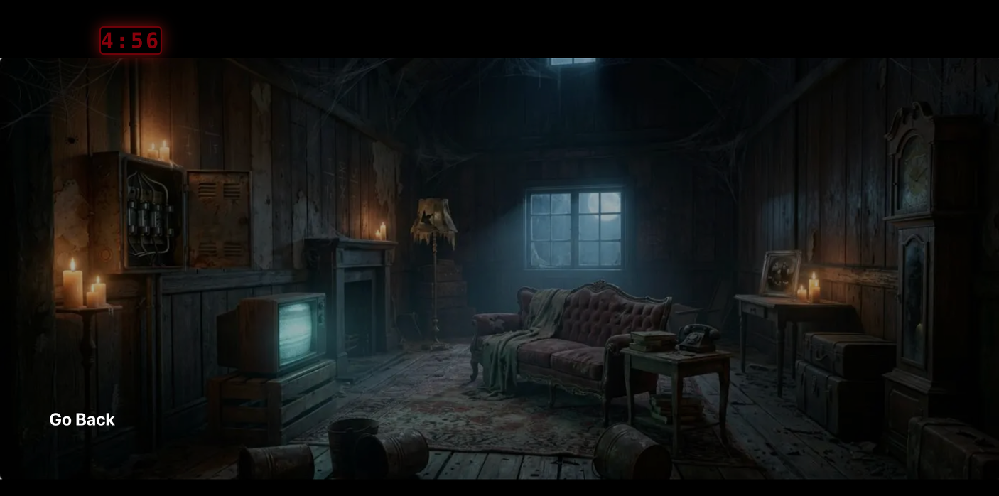

Slide 4
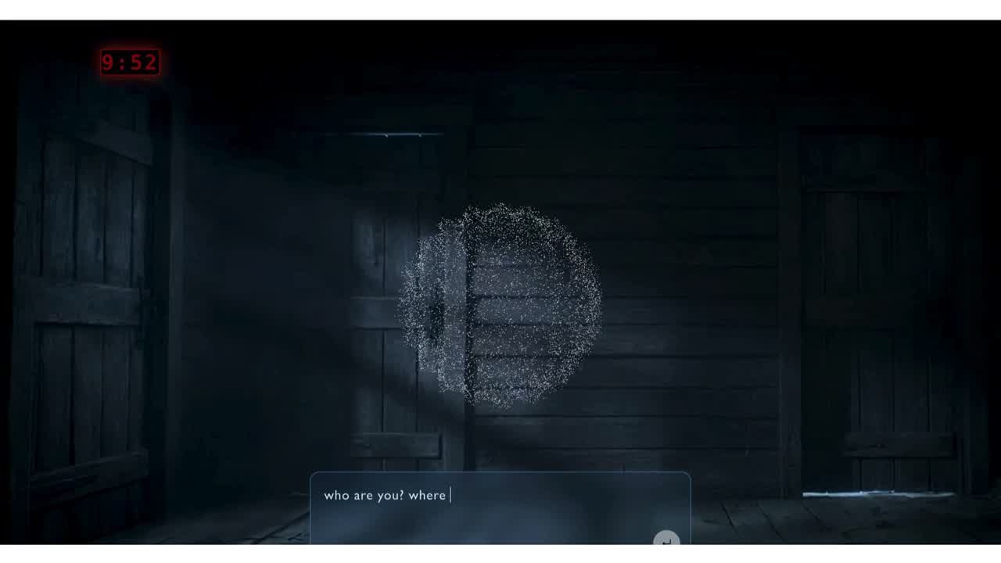

Slide 5
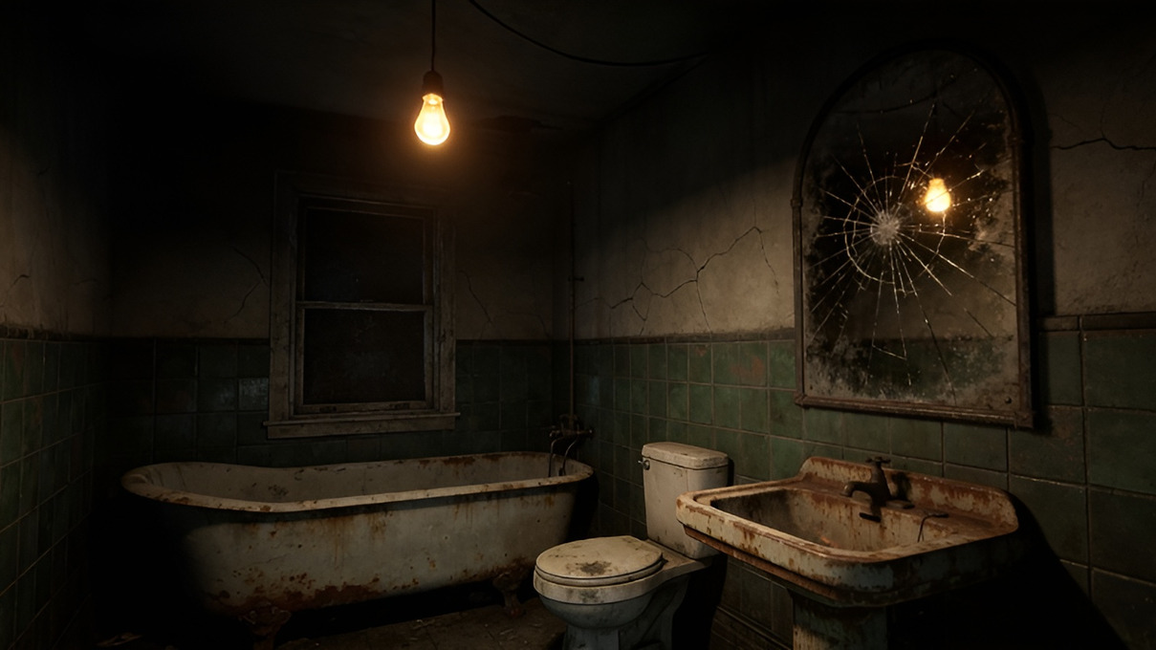

Slide 6
Tech Stack
Frontend (Interactive Layer)
- Three.js (3D Scene / Particles / Game State / Puzzle Logic )
- Next.js (Routing & UI)
↓ API Layer
Backend (Logic Layer)
- FastAPI (Validation)
↓ AI Layer
Intelligence Layer
- OpenAI Agent SDK
- LLM (Dynamic Narrative / Adaptive Hints)

Slide 7
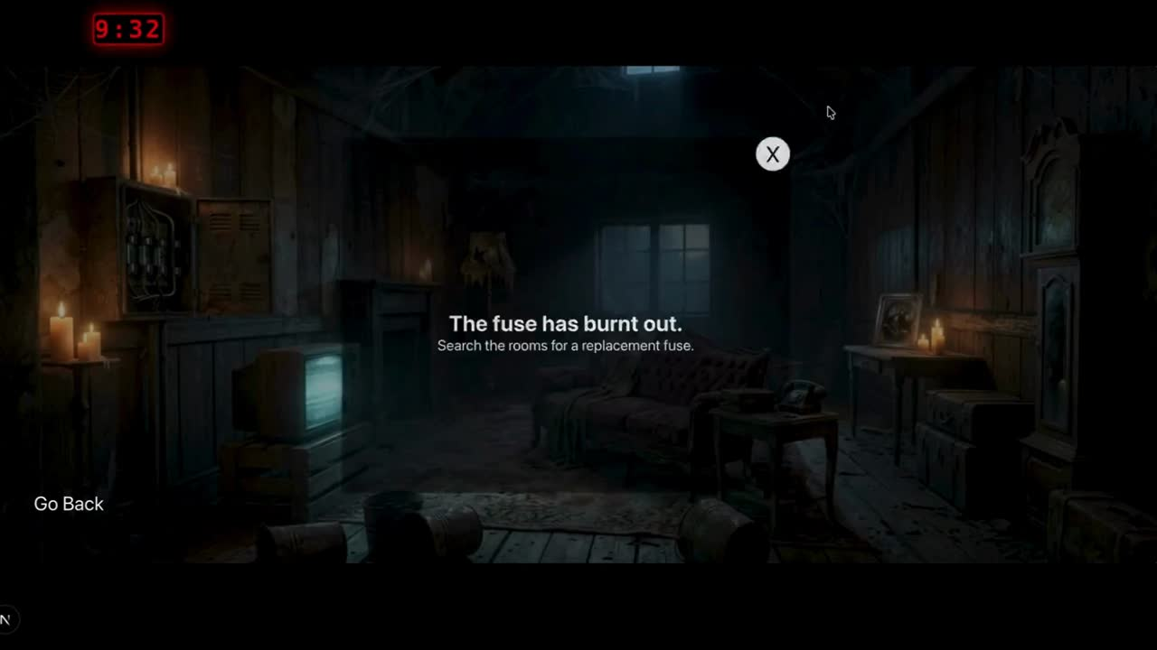

Slide 8
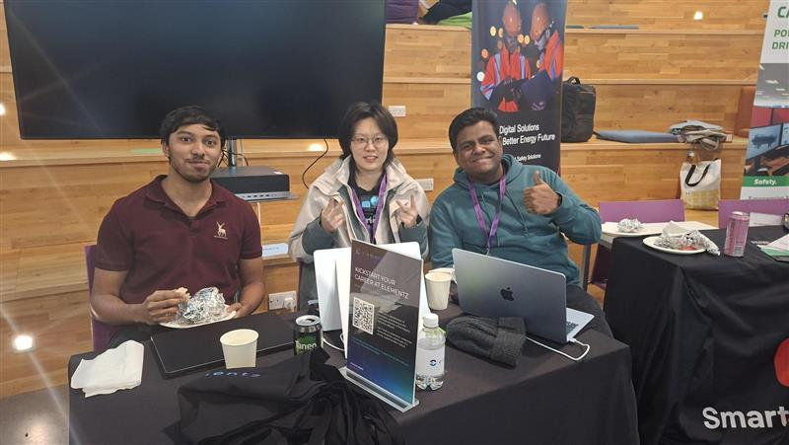
Team: HUNTERS
JAYA PAUL JOHN CHINTA
Ranjith Raveendran Kannan
Hexing Wang

Slide 9


